Slide 1


Slide 2


Slide 3
Take Your Angular App Glamping
Dennis Moon – THAT CONFERENCE August 7th, 2017

Slide 4

Glamping is a combination of glamour and camping and describes a style of camping with amenities and, in some cases, resort-style services not usually associated with "traditional" camping.

Slide 5

Married to Christine
Stepson Ian and future daughter-in-law Kaila
Hobbies: Guitar, Singing, Wineries, B&Bs
Passions: Technology, Music
Employer: CUNA MUTUAL Financial Group
Senior software architect and web designer/developer specializing in modern ASP.NET and JavaScript web technology stacks

Slide 6
My Info
Blog: https://dennismoon.com
Code Repository: https://github.com/comfycoder
Twitter: @comfycoder
Linked in:
https://www.linkedin.com/in/dennis-moon-b469b93

Slide 7
Suggested Software Prerequisites
Visual Studio 2017 (or 2015) (recommend including C++ to support angular-cli node-sass compiler)
Visual Studio Code (great IDE for JavaScript)
Chocolatey (for Windows) https://chocolatey.org/install
choco install git
choco install node
Homebrew (for Mac) https://brew.sh/
brew install git
brew install node

Slide 8
Recommended NPM Packages (for Windows)
https://www.npmjs.com/
npm install -g npm@latest (5.x+ for package locking, Yarn not needed)
npm install -g minimatch@latest
npm install -g graceful-fs@latest
npm install -g node-gyp@latest
npm install -g @angular/cli@latest
npm install -g rimraf@latest
npm install -g typescript@latest
npm install -g tslint@latest

Slide 9
Setup Your Site For Team Activities
Create Your New Team Camp Site
Support Older Camp Site Browsers
Remove The Lint From Your Camp Site
Bring Along Just The Right Amount Of Style
Where To Load Stuff That Won't Fit Into Your Pack
Refine Scripted Camp Activities
Swap Your Gear When It's Hot

Slide 10
Create Your New Team Camp Site
Angular CLI - https://cli.angular.io/
Use angular-cli to generate a new camp site:
ng new camp-comfy --routing --style=scss --prefix=cc
What's in the src folder?
https://angular.io/guide/quickstart#the-src-folder
What's in the root folder?
https://angular.io/guide/quickstart#the-root-folder

Slide 11
Basic Starter Scripts
start – Starts a webpack development server
build – Transpiles code into a small set of combined files
test – Runs Jasmine unit and component integration tests
lint – Reports and optionally fixes code syntax issues
e2e – Runs UI end-to-end integration tests on your camp site

Slide 12
Support Older Camp Site Browsers
Edit polyfills.ts to add support for additional polyfills.
Polyfills exist to support:
ES6 features on IE9, IE10, IE11
NgClass support on SVG elements on IE10 & IE 11
Web Animations required for all but Chrome, Firefox, and Opera
Date, currency, decimal and percent pipes for all but Chrome, Firefox, Edge, IE11 and Safari 10

Slide 13
Remove The Lint From Your Camp Site
ng lint --type-check
Reports only (does not fix issues), produces plain output
ng lint --type-check --format stylish
Reports only (does not fix issues), produces styled output
ng lint --type-check --fix --format stylish
Reports and fixes issues, produces styled output

Slide 14
Bring Along Just The Right Amount Of Style
Install Bootstrap 4
npm install bootstrap@next
Add Local Bootstrap Override Files
In the src folder, create two new files called:
_variables.scss (override bootstrap variables here)
_bootstrap.scss (modified copy of bootstrap.scss from node_modules)
In the styles.scss file, add the following import statements and save the file:
@import 'variables';
@import 'bootstrap';

Slide 15
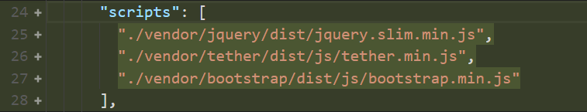
Where To Load Stuff That Won’t Fit Into Your Pack
Install your 3rd party library, as follows:
npm install library-name --save
If the library includes typings, install them using npm:
npm install @types/library_name --save-dev
Add references to them in the "scripts" section in the .angular-cli.json file, as shown in the following example:

Slide 16
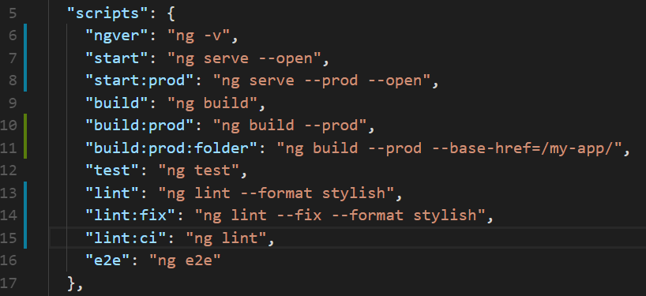
Refine Scripted Camp Activities

Slide 17
Swap Your Gear When It's Hot
Add Hot Module Replacement (HMR) to your camp site.
See the following angular-cli documentation for more information:
https://github.com/angular/angular-cli/wiki/stories-configure-hmr

Slide 18
Testing Your Camp Site Modules
Test Your Gear...Receive Good Karma
Enhance Your Karma Capabilities
Make Sure Your Stuff Is Covered
Your Camp Mascot Is A Wallaby
Smoke Test Your Camp Site End-to-End
Form A New Check-in Checklist Habit

Slide 19
Test Your Gear...Receive Good Karma
Run the test script:
ng run test
For more information on how to write unit and component tests, see the following:
https://angular.io/guide/testing

Slide 20
Enhance Your Karma Capabilities
Add Chrome Headless Support For CI
Install Code Coverage Reporting Package
Add Code Coverage Configuration Information
Example Updated karma.conf.js File

Slide 21
Make Sure Your Stuff Is Covered
Add Test Script With Code Coverage For CI Builds by editing the package.json file and add the following to the scripts section:
"test:ci": "ng test --browsers=ChromeNoSandboxHeadless --watch=false --single-run=true --code-coverage=true --reporters progress,junit,coverage-istanbul"

Slide 22
Your Camp Mascot Is A Wallaby
Add Wallaby.js support to your angular-cli project, see: https://wallabyjs.com/
Example code to integrate wallaby into your camp site project:
https://github.com/wallabyjs/ngCliWebpackSample
Note: Wallaby requires that Typescript and TSLint be globally installed.

Slide 23
Smoke Test Your Camp Site End-to-End
Run the e2e script:
npm run e2e
Protractor is an end-to-end test framework for Angular and AngularJS applications. Protractor runs tests against your application running in a real browser, interacting with it as a user would.
http://www.protractortest.org/#/
Enable protractor to run Chrome in headless mode for CI.

Slide 24
Form A New Check-in Checklist Habit
Highly recommend getting your entire camp site team to adopt a new habit of doing the following just prior to checking source code into a version control system:
Run the lint:fix script to look for and clean up syntax issues.
Run the test script to run through all of your unit and component integration tests.
Run the e2e test to run through all of your site UI end-to-end tests.
Run the build:prod script to ensure that your code can compile in production mode (to catch AoT ahead of time compile issues).
Take action after step to remediate any issues discovers by the step action.
Getting everyone into these habits from day one of your camp site build will save you many, many hours of troubleshooting undiscovered issues.

Slide 25
Camp Site Construction
Share Your Camp Tools And Services
Add Commonly Desired Camp Site Views
Add Modularized Camp Site Features
Design The Layout Of Your Camp Site

Slide 26
Share Your Camp Tools And Services
Camp site services, components, directives, pipes, etc., can also be modularized and shared among your camp site locations.
Create a module for globally available services:
npm g m services
Create a module for shared components:
npm g m shared

Slide 27
Add Commonly Desired Camp Site Views
Most camp sites have a commonly required (desired) views. These view would be part of the initial payload when the application starts. Generate the following new views:
Home: npm g c home
Error: npm g c error
Not Found: npm g c not-found
Edit the app-routing.module.ts file.
Edit the app.component.html file.
Edit the app.component.scss file.
Fix the broken unit tests.

Slide 28
Add Modularized Camp Site Features
You can organize your camp site into self-contained modules that’s can be redistributed to your fellow campers for use in their sites.
You could do something like the following:
Add a camp photos search feature using the Flickr API services.
Add a site destination lookup feature using the Google Maps services.
Add a movie trivia feature for game nights using the SWAPI (Star Wars API) services.

Slide 29
Design The Layout Of Your Camp Site
Be responsive to the diversity of your camper’s equipment.
Design the camp site container specifications that set the boundaries of your camp site.
Design the camp site header (the first thing campers see).
Design the camp site footer (the last thing campers see)
Design various camp site content styles to suit your campers personal sense of esthetics.

Slide 30
Add Some Nice-To-Have Amenities
Feeling Lazy? Load Those Features On Demand
Name Your Camp Site Locations
Update Your Current Camp Site Location
Provide Directives To Guide Campers
Let Everyone Know When You're Busy

Slide 31
Feeling Lazy? Load Those Features On Demand
Feature modules allow you to group and load related application features on demand, which helps decrease the application startup time.
No need to load everything at once, you should only load what the user expects to see when the app first appears.
Lazy loaded feature modules only get loaded when a user navigates to the feature’s route.

Slide 32
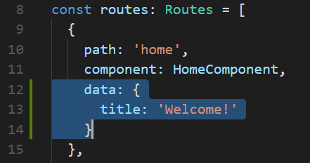
Name Your Camp Site Locations
You can identify view locations while browsing your camp site.
Add a data section with a title property to each camp site route.
Do something like the following:

Slide 33
Update Your Current Camp Site Location

Slide 34
Provide Directives To Guide Campers
Issue directives to help your campers correctly fill out their data requisition forms.
Examples:
Filter out invalid characters as they are entered into the form fields:
Names, Titles, Numbers, Decimals, Currency, Dates
Fix up and format text input values for display readability
Numbers, Decimals, Currency, Percentages, Dates

Slide 35
Let Everyone Know When You're Busy
Your campers are always eager to explore the features of your campsite.
However, in this day and age of immediate gratification, a camper’s need for immediate feedback is high. They tend to get a little impatient and want to know what’s happening at the camp site.
You should let them know when you’re busy and that progress is being made to service their requests.

Slide 36
Don't Have All Your Camp Site Supplies Yet? Mock Them Up
Generate Mock Data
Setup A JSON Server
Use Freely Available Services

Slide 37
Generate Mock Data
Here are some online tools you can use to generate mock data in JSON file format:
https://www.mockaroo.com/
http://www.json-generator.com/
http://www.theonegenerator.com/geradordejson
https://www.site24x7.com/tools/json-generator.html

Slide 38
Use A JSON Server
JSON Server is an npm package that enables you to create a fully functioning RESTful JSON web service using the JSON data file(s) you provide.
Located at GitHub:
https://github.com/typicode/json-server
You can install globally using the following:
npm install -g json-server

Slide 39
Use Freely Available Services
Search for free web service APIs.
Here are some examples:
Flickr (images): https://www.flickr.com/services/api/
SWAPI (The Star Wars API): https://swapi.co/
Google Maps: https://developers.google.com/maps/
YouTube: https://developers.google.com/youtube/
OpenWeatherMap: https://openweathermap.org/price
Here’s a large list of free web services:
https://www.programmableweb.com/apis/directory

Slide 40
Optimize Your Camp Site Resources
Reduce The Size Of Your Images
Sprites Reduce Site Downloads
Bring Along The High Quality Lightweight Gear
Minimize Your Site Resources
Build Your Own Custom Font Sets

Slide 41
Reduce The Size Of Your Images
Bitmap images, especially PNG images, are often much large than they need to be. You can reduce the total byte size of your images by running them through an optimizer process.
Here are some image optimizers for you to explore:
nQuant
https://nquant.codeplex.com/
PNGCrush
http://pngcrush.com/
PNGGauntlet
https://pnggauntlet.com/

Slide 42
Sprites Reduce Total Site Downloads
Combining your icons into a single sprite file can significantly reduce the number of downloads when your site loads in a browser.
Most browsers only support 5 to 6 concurrent file downloads, and wait until all files have completely finished downloading before getting the next set of files to download.
Here are some sprite generators for you to explore:
https://spritegenerator.codeplex.com/
http://spritegen.website-performance.org/

Slide 43
Bring Along The High Quality, Lightweight Gear
SVG, or Scalable Vector Graphics, offers a way to do full resolution graphical elements, no matter what size screen, what zoom level, or what resolution your user's device has.
With SVG files you can actually style shapes with CSS, and make them interactive with JavaScript by attaching event handlers to SVG nodes.
They can be significantly smaller than an equivalent resolution bitmap image.
Ture Story: I once worked on a project where the initially produced PNG graphic was over 2MB in size. We refactored the image as an SVG graphic, and its size was reduced to just over 37KB. That was a 98% reduction in download size of the graphic file.

Slide 44
Minimize Your Site Resources
In addition to commenting out the unwanted Bootstrap styles from being compiled into your camp site stylesheet, you have other means available to you via the angular-cli command line tool to squeeze more unused stuff out of your final build file results.
To do a production build, you must add the –prod argument to the angular-cli command line call, like the following:
ng build –prod
The angular-cli tool ensures all builds make use of bundling and limited tree-shaking, while --prod builds also run limited dead code elimination via UglifyJS.
Resources in CSS, such as images and fonts, will be copied over automatically as part of a build. If a resource is less than 10kb it will also be in-lined.

Slide 45
Build Your Own Custom Font Sets
Icon fonts have many advantages with the biggest being their free scalability to any size, while at the same time reducing server requests to an absolute minimum. However, you will not need the whole font set, and you may need icons from different font sets. Font generators can help you with both of these challenges by producing custom fonts sets and CSS. Here are some examples:
IcoMoon
https://icomoon.io/
Fontello
http://fontello.com/
Fontastic
http://fontastic.me/

Slide 46
Extra Camp Site Tasks
Monitor Camp Site Usage And Report Issues
A Simple ASP.NET Core Site To Host Your Angular SPA

Slide 47
Monitor Camp Site Usage And Report Issues
Track.js
https://trackjs.com/
Helps you track and resolve client-side errors.
Application Insights for web pages
Find out about the performance and usage of your web page or app, get timings of page loads and AJAX calls, counts and details of browser exceptions and AJAX failures, as well as users and session counts.
https://docs.microsoft.com/en-us/azure/application-insights/app-insights-javascript

Slide 48
A Simple ASP.NET Core Site To Host Your Angular SPA
See example in my GitHub repository:

Slide 49
Camp Comfy Cookbook
Coming Soon…

Slide 50
Learning Site Links
Angular.io
https://cli.angular.io/ (Angular CLI)
https://github.com/angular/angular-cli/wiki (Angular CLI)
https://angular.io/guide/quickstart
https://angular.io/tutorial
Rangle.io Angular Training Book
https://angular-2-training-book.rangle.io/

Slide 51
Pluralsight Videos
Pluralsight offers you the best training you will find for your money. The training comes in short video segments organized by category. You can watch them over and over as many times as needed to reinforce your knowledge and get just in time architectural guidance from the best.
Here are my favorite videos from my Angular journey:
Angular CLI - John Papa (do every task in this video to quickly master the use of angular-cli)
https://app.pluralsight.com/library/courses/angular-cli/table-of-contents
Angular: Getting Started - Deborah Kurata
https://app.pluralsight.com/library/courses/angular-2-getting-started-update/table-of-contents
Angular Fundamentals - Joe Eames
https://app.pluralsight.com/library/courses/angular-fundamentals/table-of-contents

Slide 52
Pluralsight Videos (continued)
Angular Routing - Deborah Kurata
https://app.pluralsight.com/library/courses/angular-routing/table-of-contents
Play by Play: Angular 2/RxJS/HTTP and RESTful Services - John Papa and Dan Wahlin
https://app.pluralsight.com/library/courses/play-by-play-angular-2-rxjs-http-restful-services-john-papa-dan-wahlin/table-of-contents
Angular Reactive Forms - Deborah Kurata
https://app.pluralsight.com/library/courses/angular-2-reactive-forms/table-of-contents

Slide 53
Shiny New Tool
Online VS Code IDE for Angular & React
https://stackblitz.com/

Slide 54


